Slide 1
Sharing e.GO
Team Haths

Slide 2
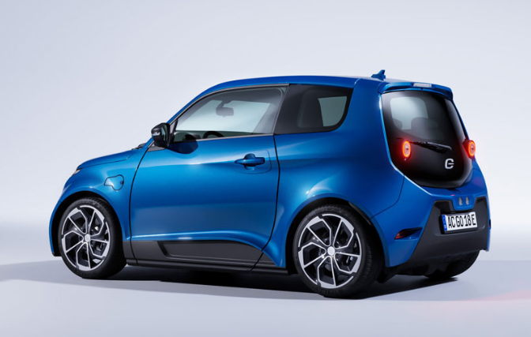
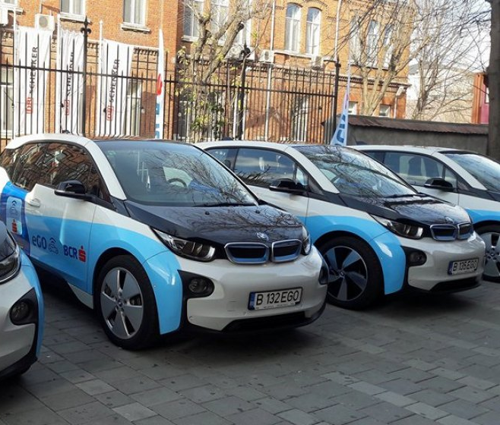
OUR IDEA
Based on sharing ego-digital cars.
More Efficiency
Much Money Save
Environmental friendly

Slide 3
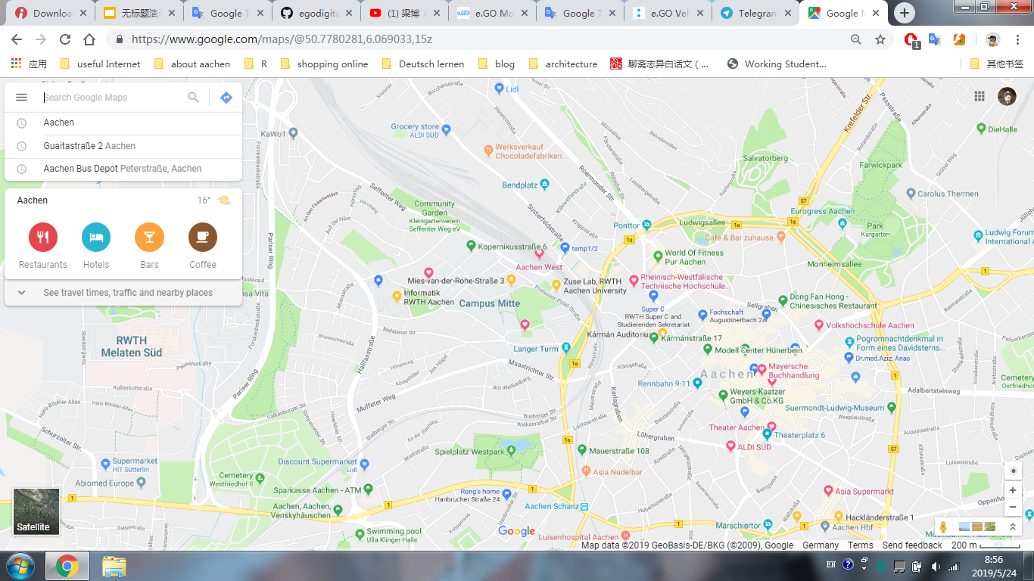

Easycar App
Based on Sharing Cars Location
nearst sharing cars recommendation
User set starting point on App, get nearest eGOs infos.
distance
remaining battery
basic status
user choose his/her ideal car and use it.

Slide 4
Easycar App
2. Smart e.GO is analogy to smart home
remotely fetch data through car sensors
setting and controllng car in advance
z.B: In Cold winter 7:30am drive to work. by Easycar App the car can be before heated and Enginee could also be started up and warm up.
Save your time & Comfortable

Slide 5
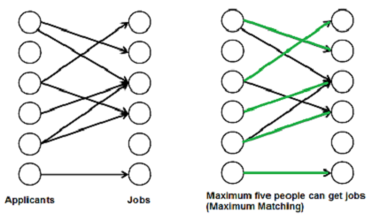
Continue and outlook - Selfdriving sharing e.GO
Based on maximum matching bipartite graph
algorithm -> Global Optimum.
Weight = T(user wating time)*λ+D(distance)

Slide 6
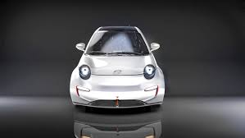
Thank you for your Attention!

